Slide 1
Rating Prediction Based On User Reviews
Aniketh Sukhtankar
Harika Bukkapattanam
Raheen Mazgaonkar
Rameshwari Obla
Shikha Mehta
Suyog Daga

Slide 2
Table Of Contents
Introduction
Preprocessing
Naive Bayes
Dataset Description
K Nearest Neighbors
Experimental Results
Overview
Random Forest
Future Improvements

Slide 3

Introduction
Various platforms are present for people express their views on a matter
To get a general public opinion one may have to read all the views on the matter
This leads to a subclass of data mining problems: sentiment analysis

Slide 4
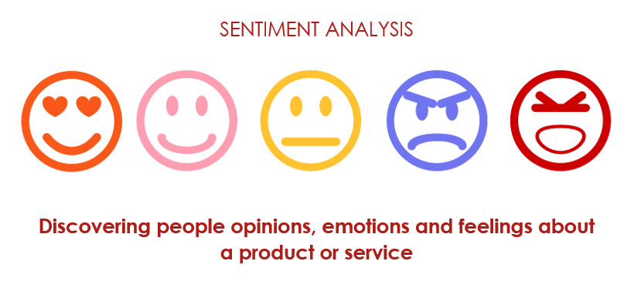
Purpose
Success of Product
Enhance Customer Experience
Competitive Advantage

Slide 5

Goal
The goal of our project is to identify the rating of a review based on its text.
Predict restaurant ratings based on their reviews from Yelp Database

Slide 6
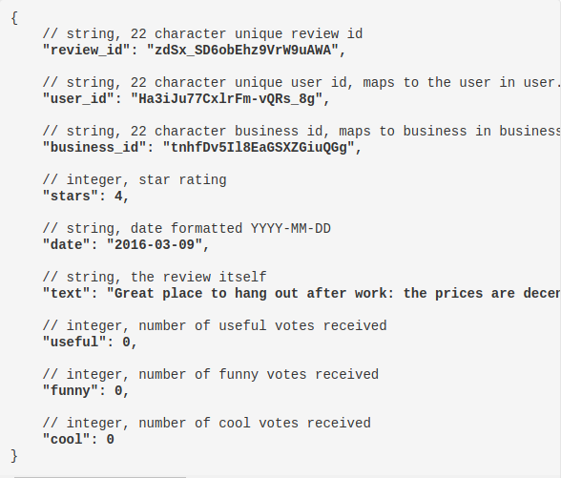
Dataset Description
Yelp Dataset
User
Business
Reviews
JSON -> CSV
Size : Around 19 GB

Slide 7


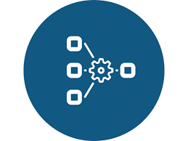

Overview
Reviews
Data Preprocessing
Classification
Rating

Slide 8
Data Preprocessing: Feature Engineering
We filtered out the restaurant related user-reviews in the given Yelp dataset for building our rating prediction model.
A new feature i.e the sentiment score is generated based on user-review text which will give a correct indication of a user’s negative/positive feeling towards a business.
We describe our efforts towards building a model which predicts rating using Latent Dirichlet Allocation (LDA) topic distribution with an added sentiment layer by extracting topics and sentiment associated with the review from user-reviews text.
A vectorized reviews corpus is built by filtering out the irrelevant stop words, punctuations as well as the case sensitivity.

Slide 9
Data Preprocessing: LDA & Sentiment Analysis
Step 1
Step 2
Step 3
Key feature extraction is performed from the reviews using Latent Dirichlet Allocation resulting in a topic based distribution model for the consolidated user-reviews corpus.
Vectorized version of the consolidated reviews data is used to train a Naive Bayes classifier and build a model for the sentiment prediction supervised by user given review stars.
One to five star based topic distributions are obtained using the built LDA model and the corresponding star based corpus.

Slide 10
Data Preprocessing: Model Input
In the field of opinion mining and sentiment analysis, the goal is to design and use a method or tool for automatic identification of conceptual information such as views, attitudes, and sentiments in a text document.
Detection of these topics is a necessary part of the process of retrieving more detailed information, but the absence of a sentiment analysis on the extracted topics may undermine the quality of the results.
This is because users are interested not only in the overall sentiment of a review and its topical information, but also to the sentiment or opinion associated with each topic.
Hence, a combination of both has been implemented to help us build the input comprising of relevant determining features in our input to the classification algorithms.
The input to model finally consists of hand picked major user review topics combined with an additional sentiment feature thus eliminating the processing redundancy of the enormous review corpus.

Slide 11
Algorithms
1
K Nearest Neighbor
2
Random Forest
3
Multinomial Naive Bayes

Slide 12
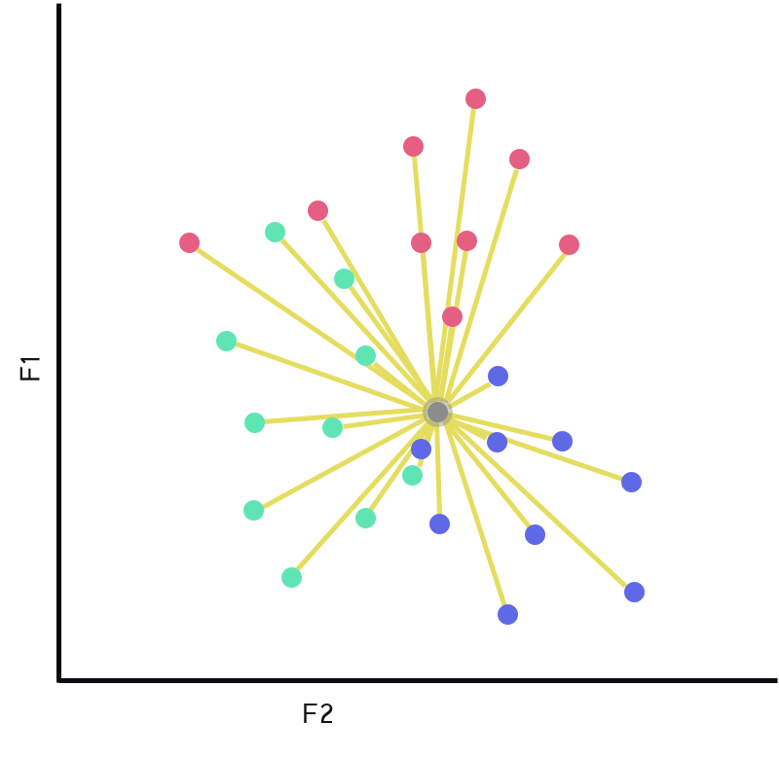
K Nearest Neighbor
K-Nearest Neighbours is one of the most basic yet essential classification algorithms in Machine Learning.
KNN is a lazy learner, because they defer the decision on how to generalize beyond the training data until each new query instance is encountered.
KNN cannot work directly with text data. It works with the feature vector which is obtained as a result of the data pre processing step.

Slide 13
Why KNN ?
Simple and effective
No actual learning or modeling is required prior to classification.
1
5
Very few parameters to tune: distance metric and k
7
2
Non-parametric.
6
Robust in terms of not requiring the categories to be linearly separated.
Classifier can be updated online at very little cost as new instances with known classes are presented.
3
7
4
Performs well when the dataset is large enough.
8
The training phase for kNN consists of simply storing all known instances and their class labels
7
Notes:
Non - parametric - It does not make any underlying assumptions about the distribution of data.

Slide 14
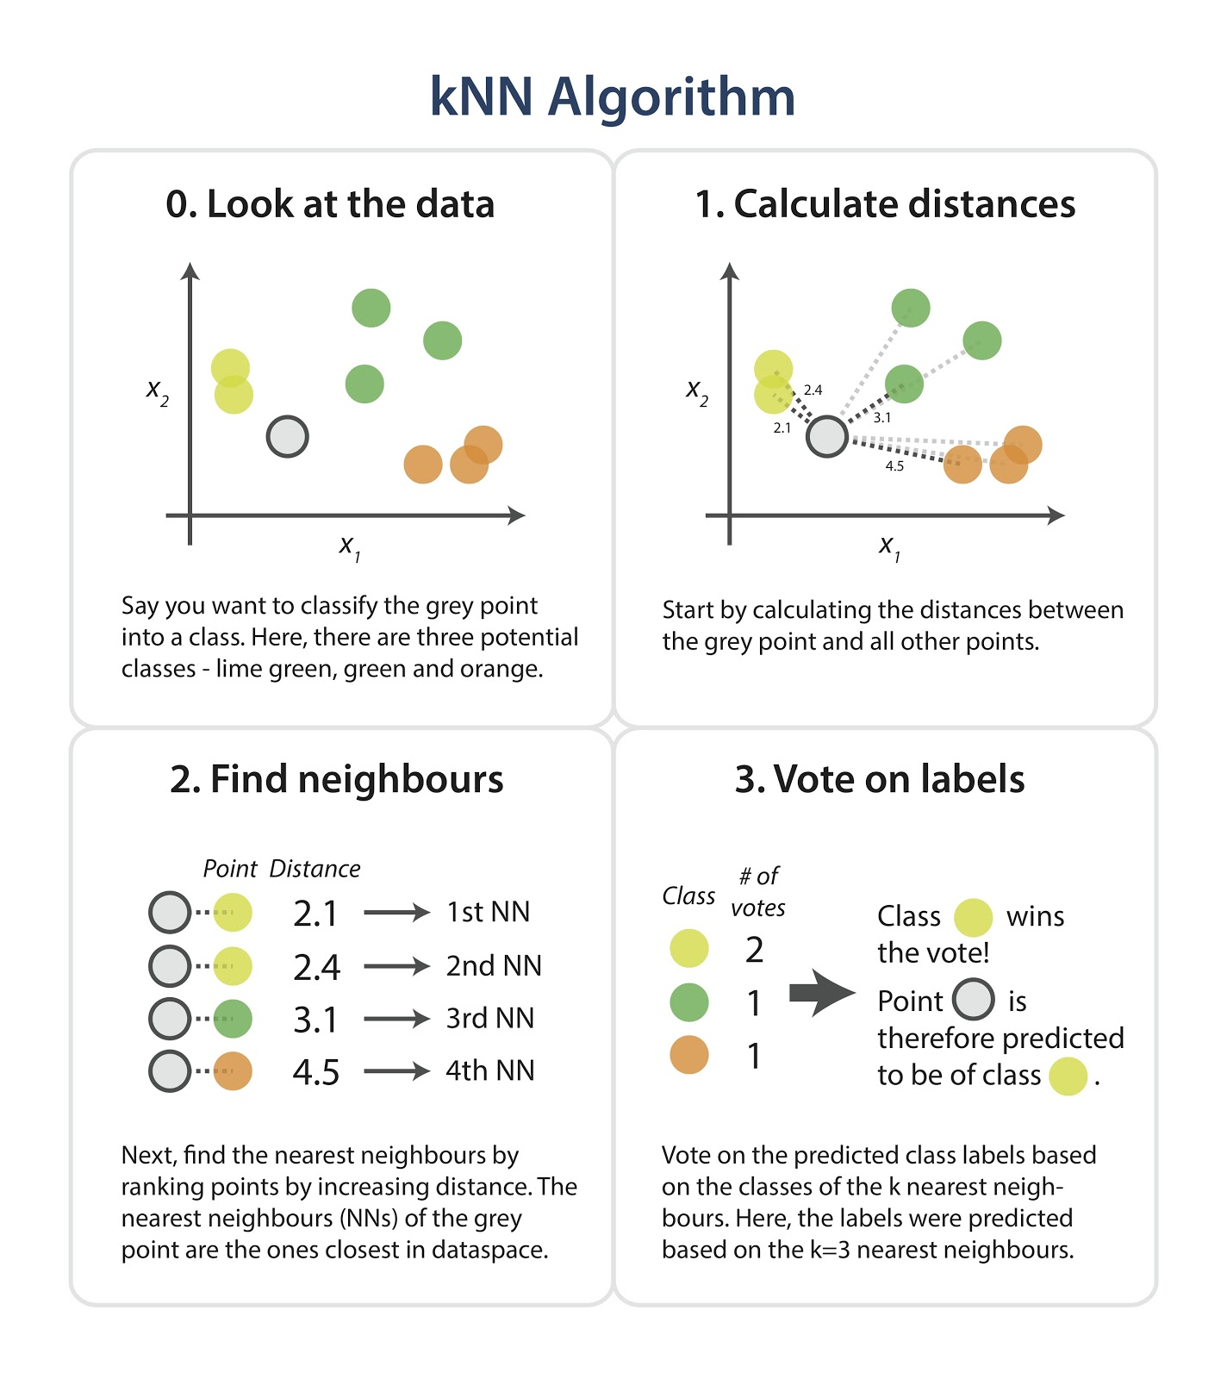

Slide 15
KNN Implementation
Principle: Points that are close in the space belong to the same class.
01 | Calculate similarity between test data and each neighbor - Euclidean distance.
02 | Select k nearest neighbors of a test data among training samples - k=5.
03 | Assign test data to the class which contains most of the neighbors - weight = uniform
Notes:
Weight = uniform: All points in each neighborhood are weighted equally. Closer neighbors of a query point will not have a greater influence than neighbors which are further away.

Slide 16
Random Forest
Decision trees involve the greedy selection of the best split point from the dataset at each step.
Susceptible to high variance if they are not pruned.
Can be reduced by creating multiple trees with different samples of the training dataset (different views of the problem) and combining predictions known as bagging.

Slide 17
Random Forest
Drawback: Very similar split points are chosen in each tree leading to high correlation. Makes their predictions similar. Mitigates variance.
Solution: Force the decision trees to be different by limiting the features (rows) that the greedy algorithm can evaluate at each split point when creating the tree.
This is called the Random Forest algorithm.

Slide 18
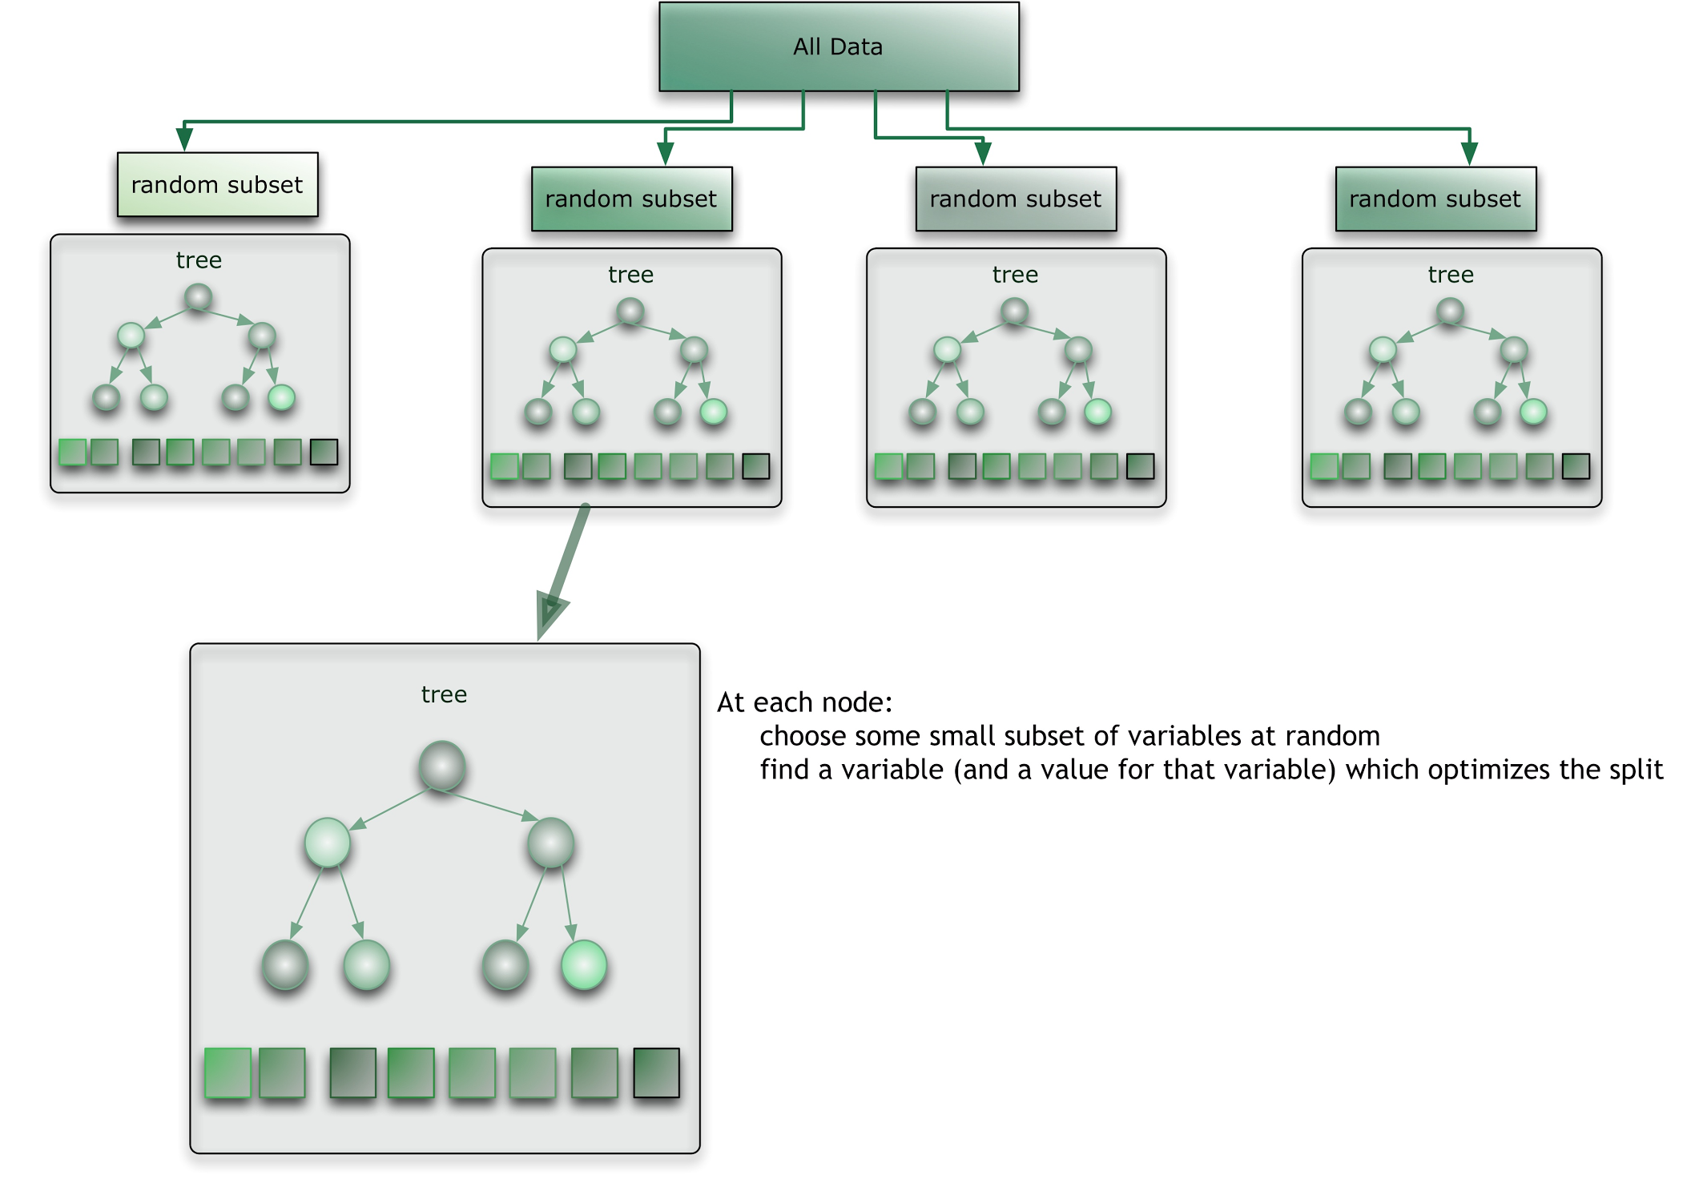
Random Forest Classifier
Like bagging, multiple samples of the training dataset are taken and a different tree trained on each.
Difference is that at each point a split is made in the data and added to the tree, only a fixed subset of attributes can be considered.
The result of this one small change are trees that are more different from each other (uncorrelated) resulting predictions that are more diverse and a combined prediction that often has better performance that single tree or bagging alone.

Slide 19
Why Random Forest ?
1
Unexcelled in accuracy
5
Can be saved for future use
2
Runs efficiently on large data bases.
6
Fast
7
3
Estimates what variables are important
7
Random forests does not overfit. You can run as many trees as you want.
4
Has an effective method for estimating missing data and maintains accuracy when a large proportion of the data missing.
Major memory requirement is the storage of the data itself.
7
8

Slide 20
The Random Forest Algorithm
Random Forests grows many decision trees. To classify a new object from an input vector, the input vector is put down each of the trees in the forest. Each tree gives a classification, and we say the tree "votes" for that class. The forest chooses the classification having the most votes (over all the trees in the forest). Each tree is grown as follows:
01 | Sample N cases at random - with replacement, from the original data. This sample will be the training set for growing the tree.
02 | If there are M input variables, a number m<<M is specified such that at each node, m variables are selected at random out of the M and the best split on these m is used to split the node. The value of m is held constant during the forest growing.
03 | At the next node, choose another m variables at random from all predictor variables and do the same. Each tree is grown to the largest extent possible. There is no pruning.

Slide 21
The Random Forest Algorithm
In the original paper on random forests, it was shown that the forest error rate depends on two things:
01 | The correlation between any two trees in the forest. Increasing the correlation increases the forest error rate.
02 | The strength of each individual tree in the forest. A tree with a low error rate is a strong classifier. Increasing the strength of the individual trees decreases the forest error rate.
Reducing m reduces both the correlation and the strength. Increasing it increases both. Somewhere in between is an "optimal" range of m - usually quite wide.

Slide 22
Why Multinomial Naive Bayes ?
Naive Bayes Assumption : Attributes for the example are independent of each other given the context of the class.
Simplified calculations , learning process becomes easy.
Works well in classification problems, where number of attributes is large.
Document Classification: Attributes for the example to be classified are topics, number of different topics could be very large.

Slide 23
Multinomial Naive Bayes
Simple Naive Bayes:
Models the document as the presence and absence of particular topics.
Multinomial Naive Bayes:
Specialized version of Naive Bayes, more suitable for text documents.
Explicitly models the topic counts where document is represented by set of topic occurrences from reviews.
For probability calculation, one multiplies the probability of topics that occur.
Individual topic become “events” and document is collection of topic events.

Slide 24
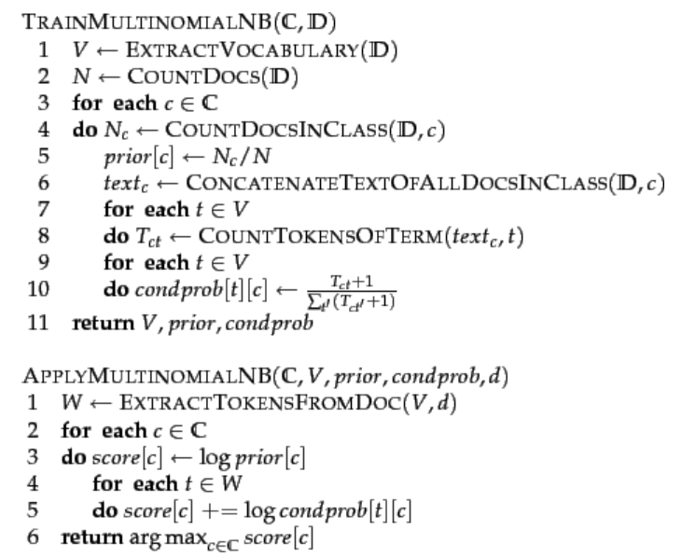
Multinomial Naive Bayes
Algorithm
TRAINMULTINOMIALNB (C,D)
Function for training the classifier.
APPLYMULTINOMIALNB(C,V,prior,condprob,d):
Used for estimation.

Slide 25
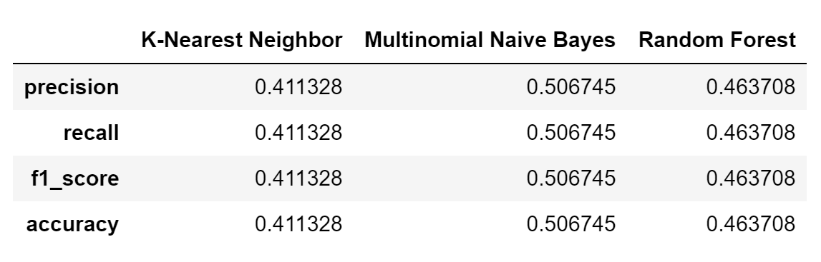
Experimental Results : LDA

Slide 26
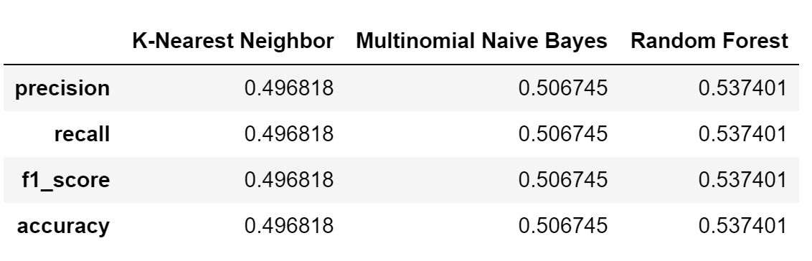
Experimental Results : LDA + Sentiment Score
We achieved an accuracy of
54%
in predicting rating stars from review
Notes:
This is due to the fact that topics do not have a sentiment associated with them.

Slide 27
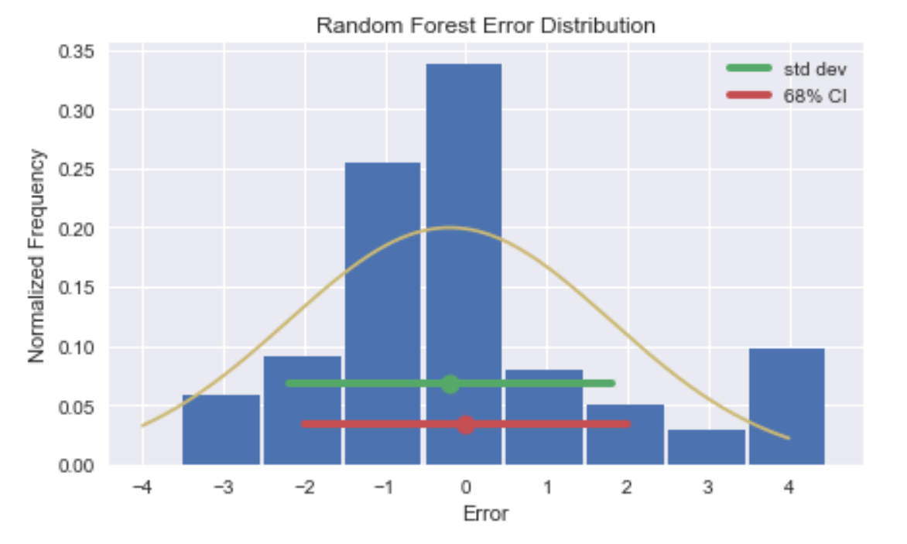
Probability Distribution of Error : Random Forest
Notes:
These are plots for probability distribution

Slide 28
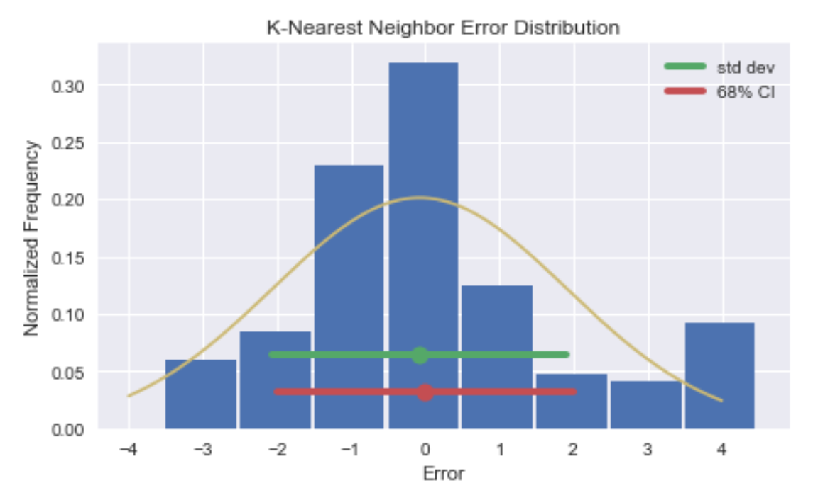
Probability Distribution of Error : kNN
Notes:
These are plots for probability distribution

Slide 29
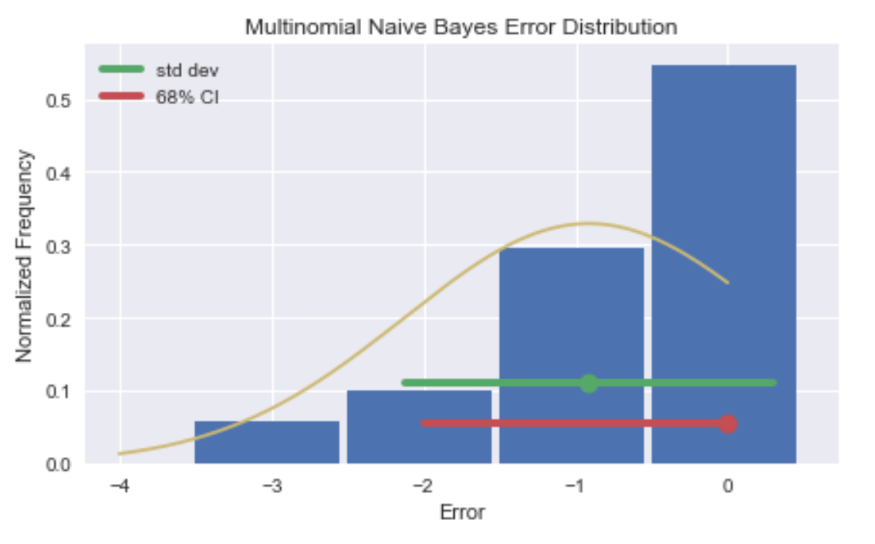
Probability Distribution of Error : Naive Bayes
Notes:
These are plots for probability distribution

Slide 30
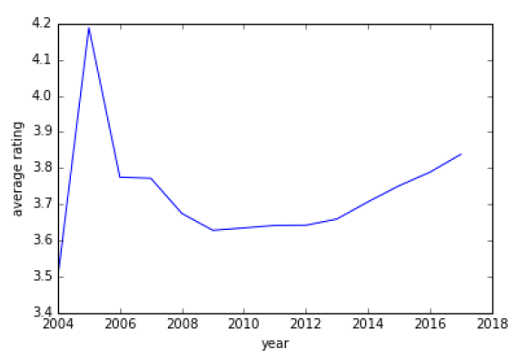
Limitation
Average star rating is unstable during 2004-09 due to low number of reviews
Average rating over the years
Notes:
From the figure on the right, we can observe that average rating increases with every year from 2010 onwards. But from 2004 to 2009, the rating is kind of unstable, mainly due to low number of reviews. This might be due to the fact that it was during the initial phase of Yelp.
To meet our dataset size requirements, we retained reviews during this period. But as more data is collected over the years, we can discard these reviews for a more consistent representation.

Slide 31
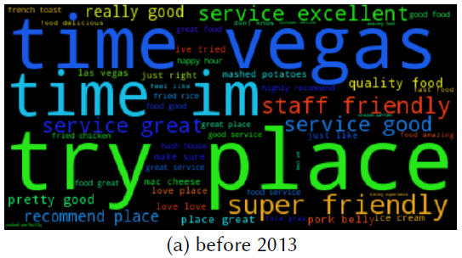
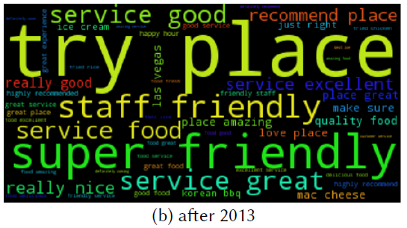
Future Improvements
Reviews after 2013 became more focused towards the quality of service and behavior of the staff
Slope for average rating also increases significantly after 2013
Therefore temporal effect affects restaurant ratings
Notes:
From these word clouds, we can see the difference in how users review restaurants in terms of the words they used before and after 2013. The reviews after 2013 became more focused towards the quality of the service and behavior of the staff. From the same time onwards, we can notice that the slope for average rating increases significantly. This shows that temporal effect also determines prediction.

Slide 32
Future Improvements
Include temporal effect in our model by using different model parameters for years <= 2013 and >2013
Assess accuracy with tf-idf features set derived from n-grams in the data
Study results from other classification techniques like Logistic Regression, AdaBoost, etc.
Notes:
After pre-processing and eliminating stop words, unique terms in the corpus can be treated as unigrams. These give us a bag-of-words model of our data, which is a widely used representation in NLP and worth exploring for our problem statement. To also capture the effect of phrases such as `not delicious' or`tasty fish burger', we can further include bigrams and trigrams, and compute tf-idf features from them for classification.

Slide 33
Thank you.

